Slide 1
voting
cassandra moe, nebai hernandez, ritika iyer, zakiya sheikh.
Notes:
cass

Slide 2
problem
Notes:
cass

Slide 3
problem statement
there is low voter turnout among young people (ages 18-24) in the United States in local and state elections, as many students attend out-of-state universities and are unaware of the absentee ballot process.
Notes:
cass

Slide 4
research
competitive analysis
Notes:
cass

Slide 5
Belgium
Sweden
Same-Day Elections
Generous Voting Regulations
Notes:
cass

Slide 6
Canada
United States
Student-oriented campaigns
Automatic Voter Registration
Notes:
cass

Slide 7
research
surveys + interviews
Notes:
ritika

Slide 8
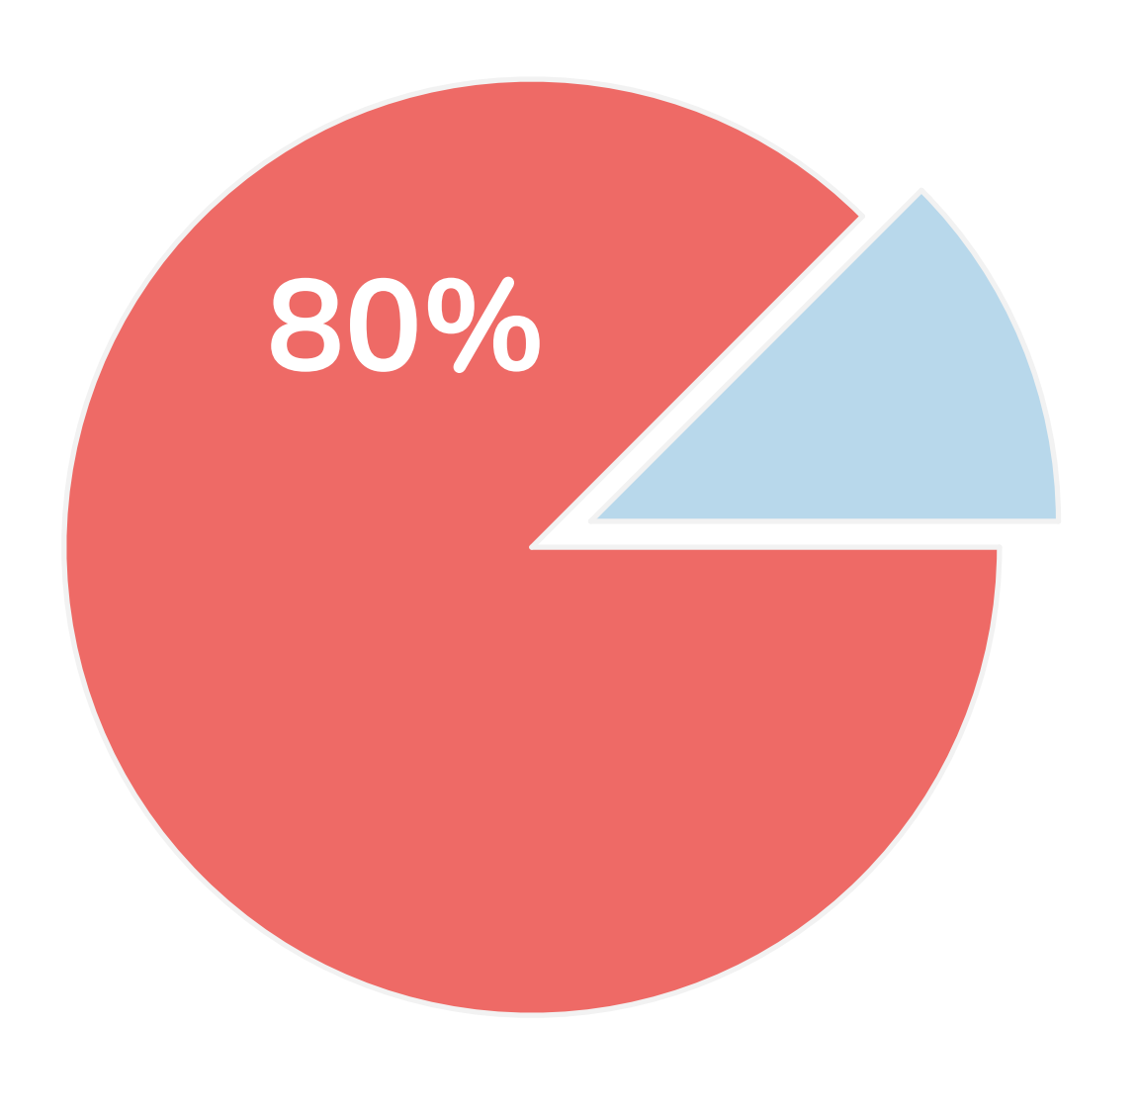
surveys
80% registered 20% unregistered
“I registered as soon as I could. My friends’ and teachers’ constant harassment was
motivation to register.”
- Anonymous Interviewee
Notes:
ritika

Slide 9
surveys
“No, I have not yet registered. I keep forgetting to do it since it is pretty inconvenient to register on my own but I know that eventually, I have to.”
- Lauren, 18, Massachusetts
31.3% of unregistered students forgot to register
Notes:
ritika

Slide 10
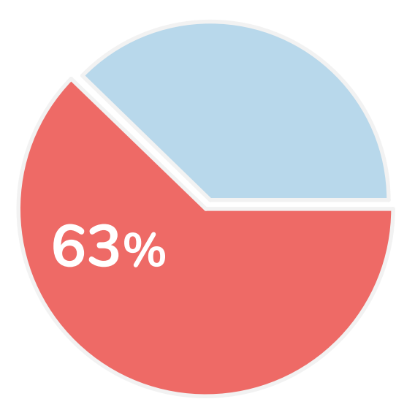
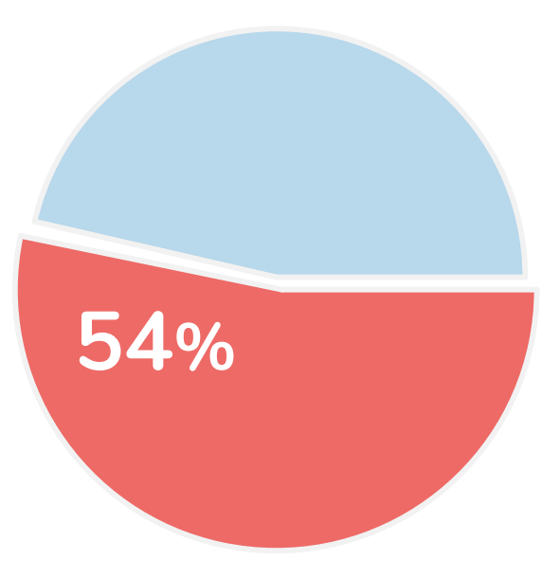
surveys: information touch points
university
word of mouth
social media
word percentage based on number of respondents who agreed they received election information from the respective source
Notes:
ritika

Slide 11
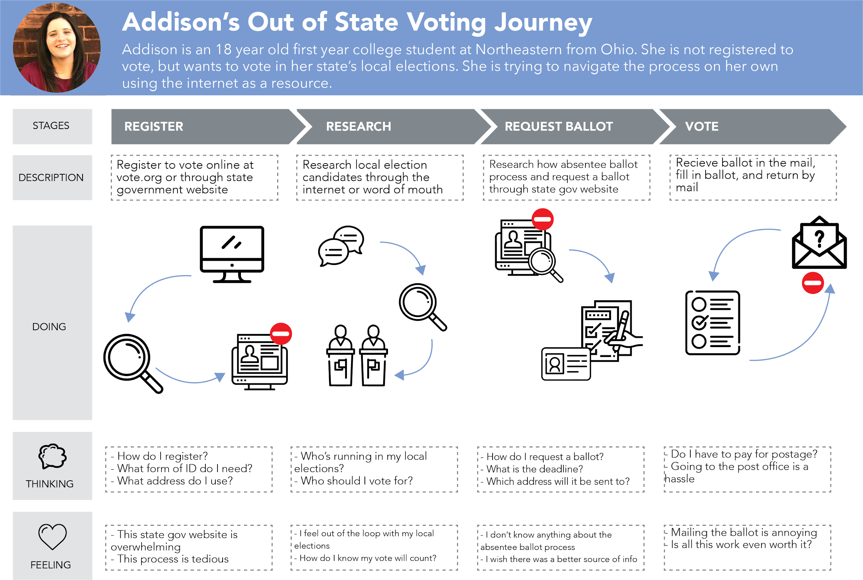
experience map
Notes:
zakiya

Slide 12
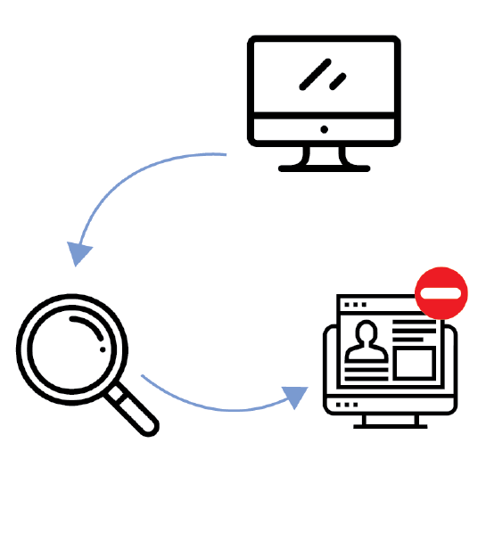
Step 1: Register
Go online
Lack of clear/concise info
Research
State government website
Notes:
zakiya

Slide 13
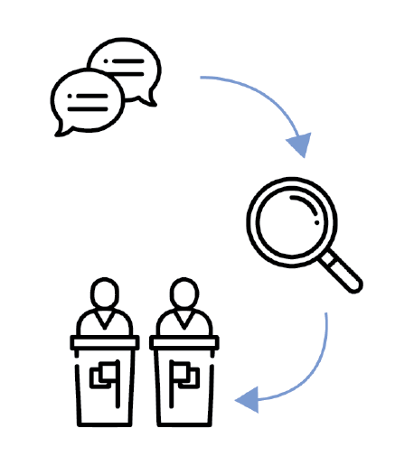
Step 2: Research
“Who is running in my local elections?”
Word of mouth
“Who should I vote for?”
Research
Town halls
Notes:
zakiya

Slide 14
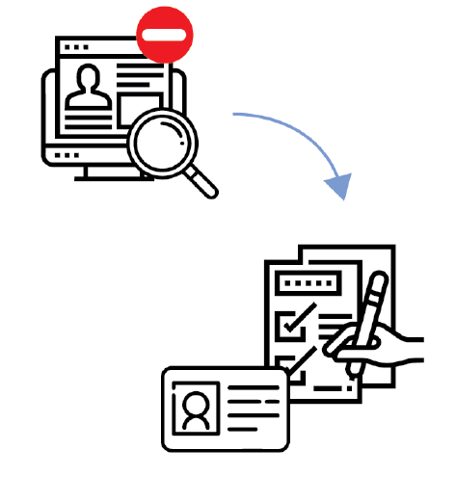
Step 3: Request Ballot
Lack of clear/concise info
State gov’t website
“I’m not aware of absentee ballots, actually.”
- Shreya, 18
Provide ID and fill out form

Slide 15
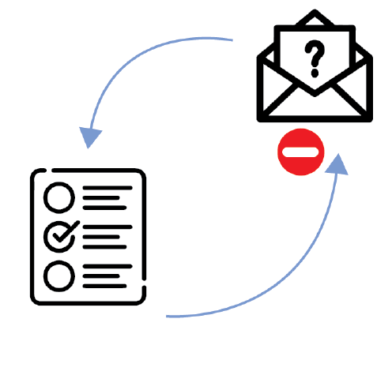
Step 4: Submit Ballot and Vote
“[Submitting a ballot] is an inconvenience. If it was more convenient I would.”
-Veronica, 23

Slide 16
usability testing #1
Notes:
ritika

Slide 17
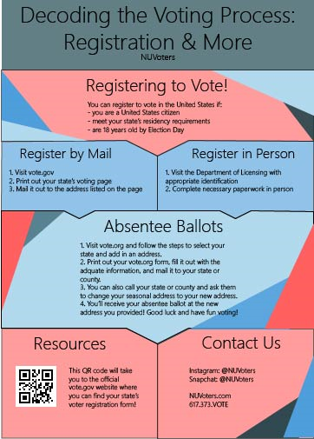
online surveys
hierarchy
relevancy
simplicity
Notes:
ritika

Slide 18
solution
our intervention
Notes:
zakiya

Slide 19
our solutions
physical intervention
booths on campus
design intervention
infographics, stickers
online intervention
periodic emails
Notes:
zakiya

Slide 20
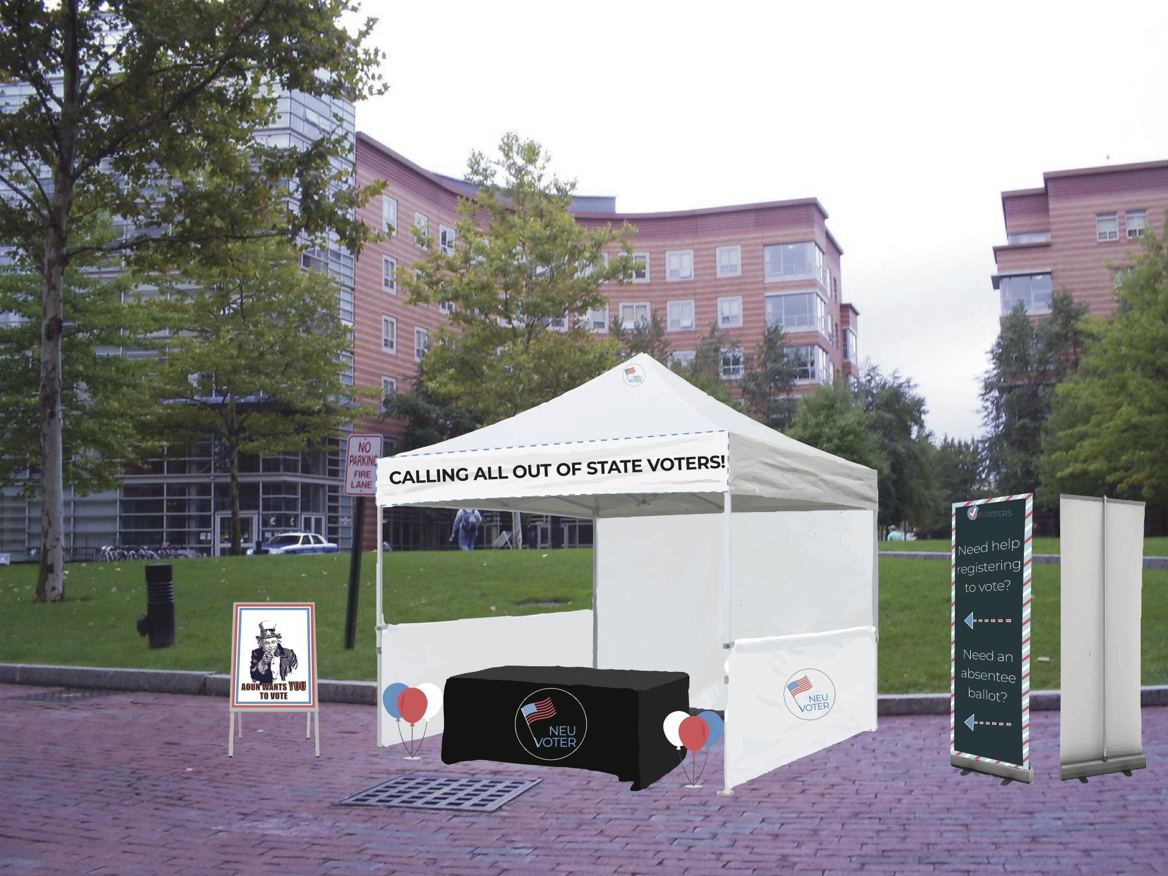
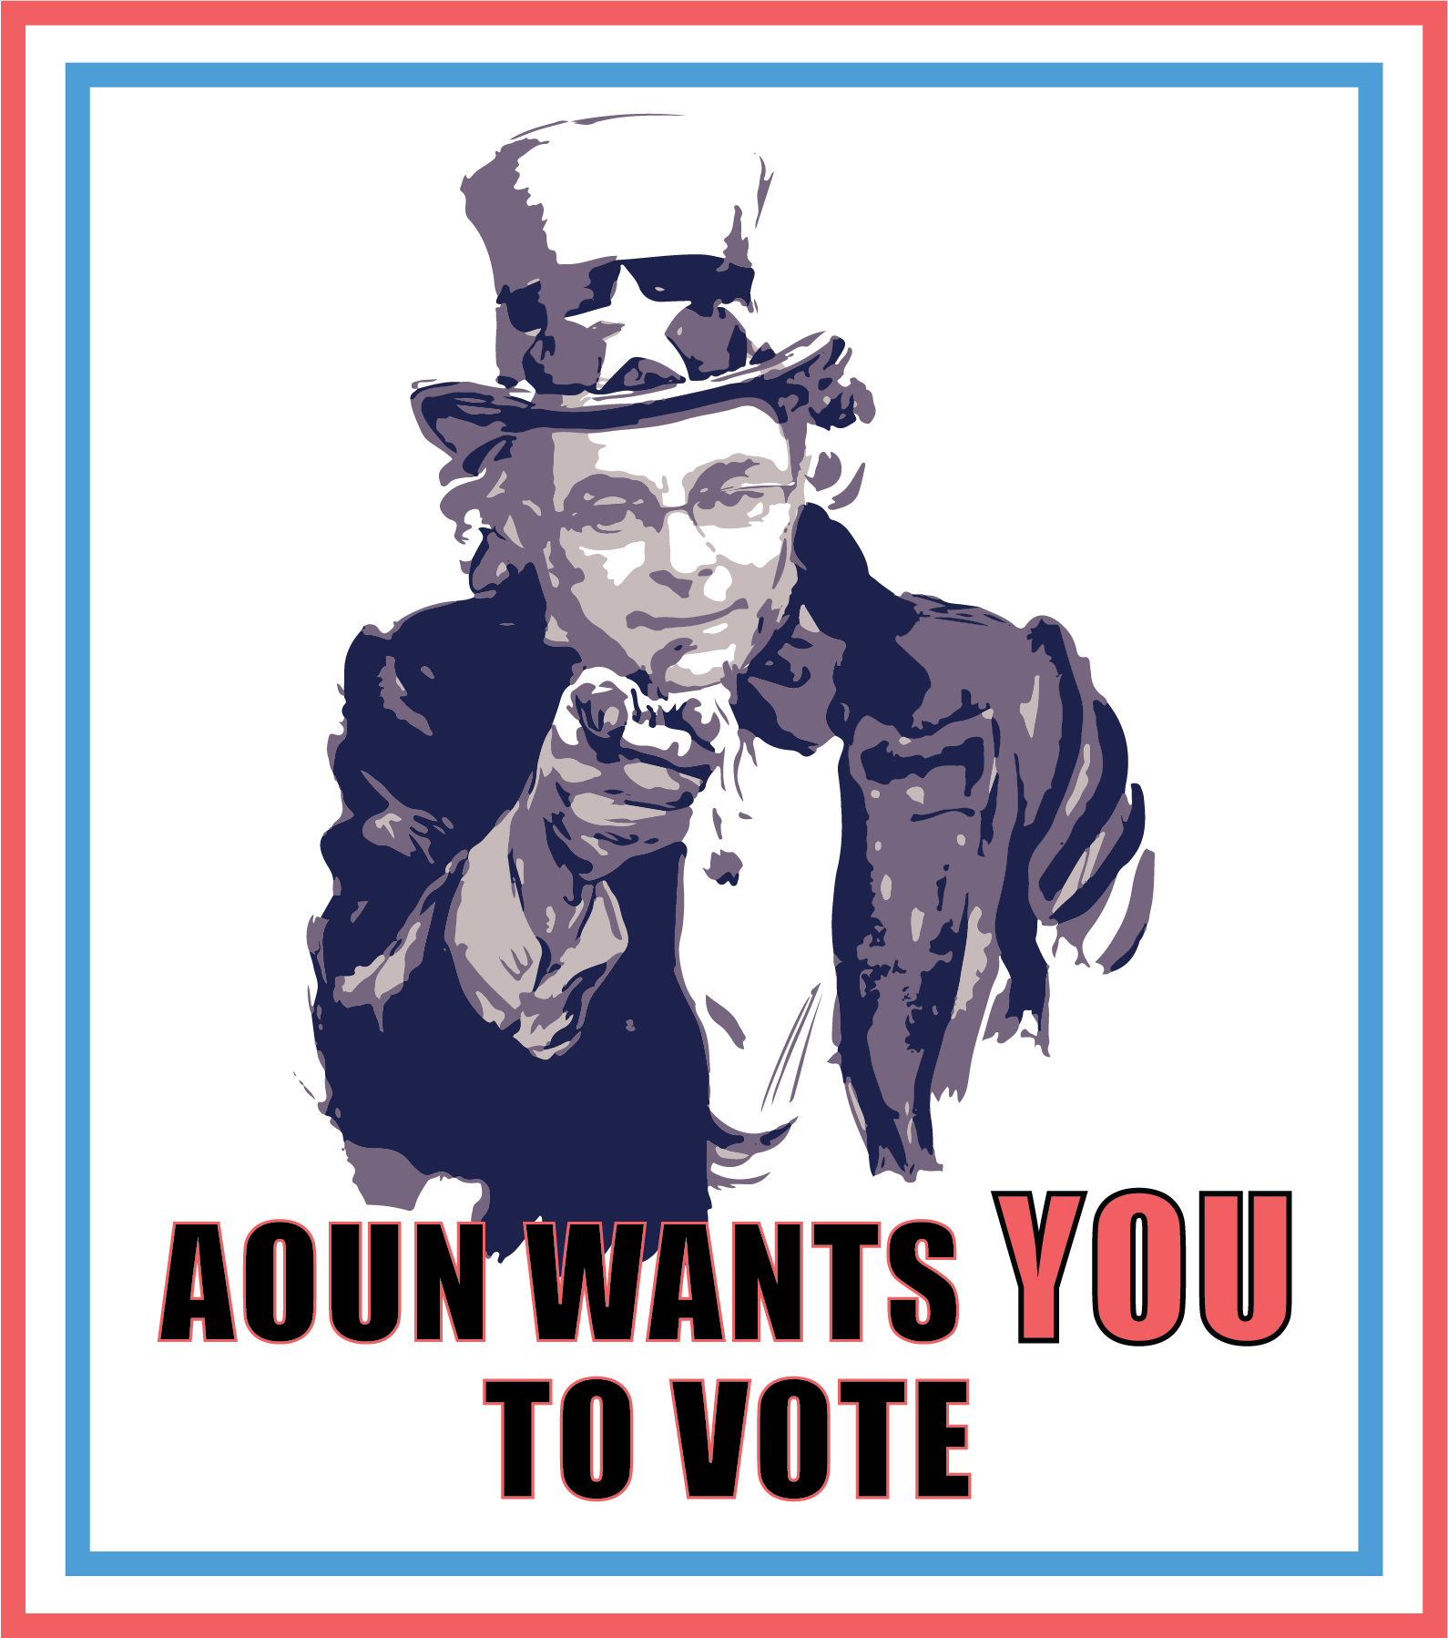
physical intervention
Notes:
zakiya

Slide 21
Notes:
zakiya

Slide 22
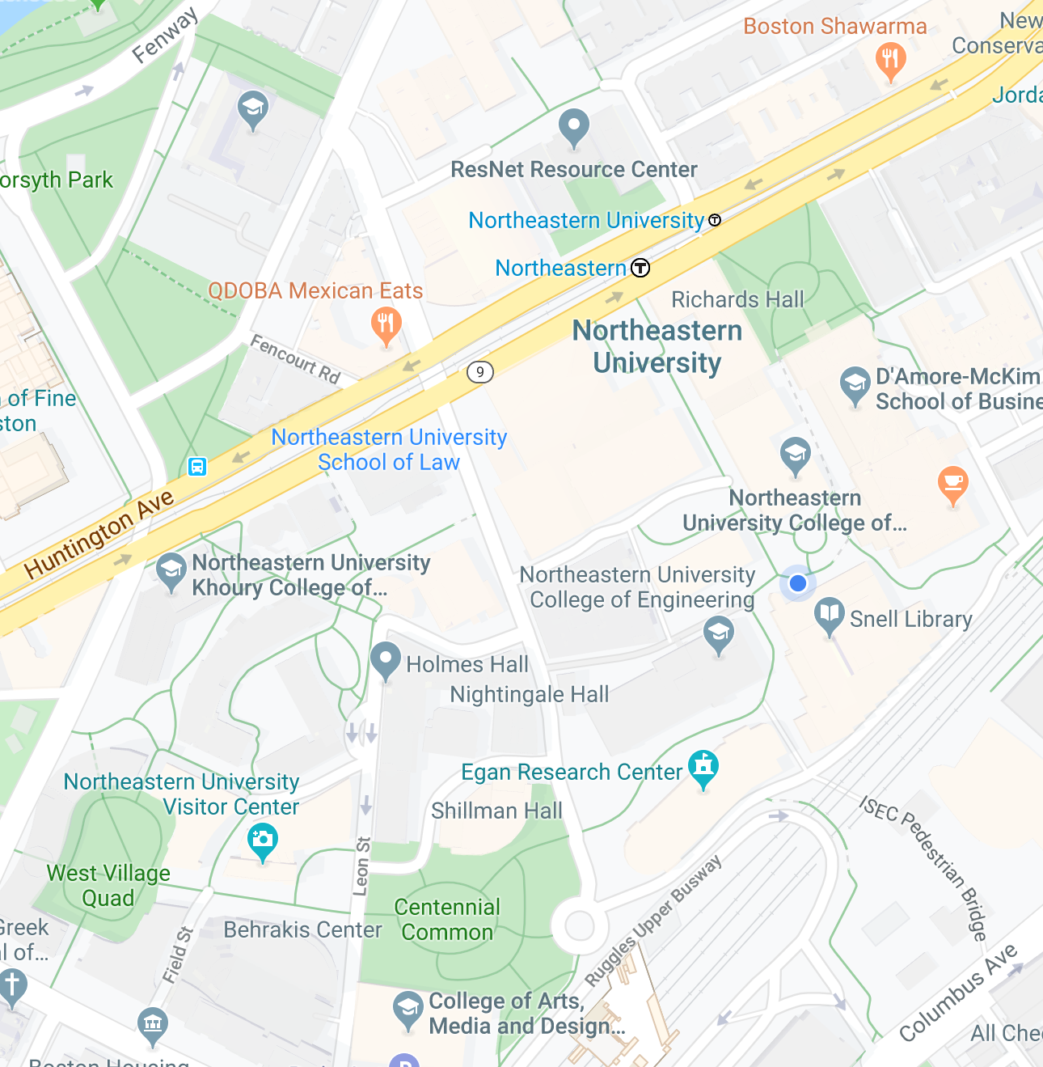
Notes:
zakiya

Slide 23
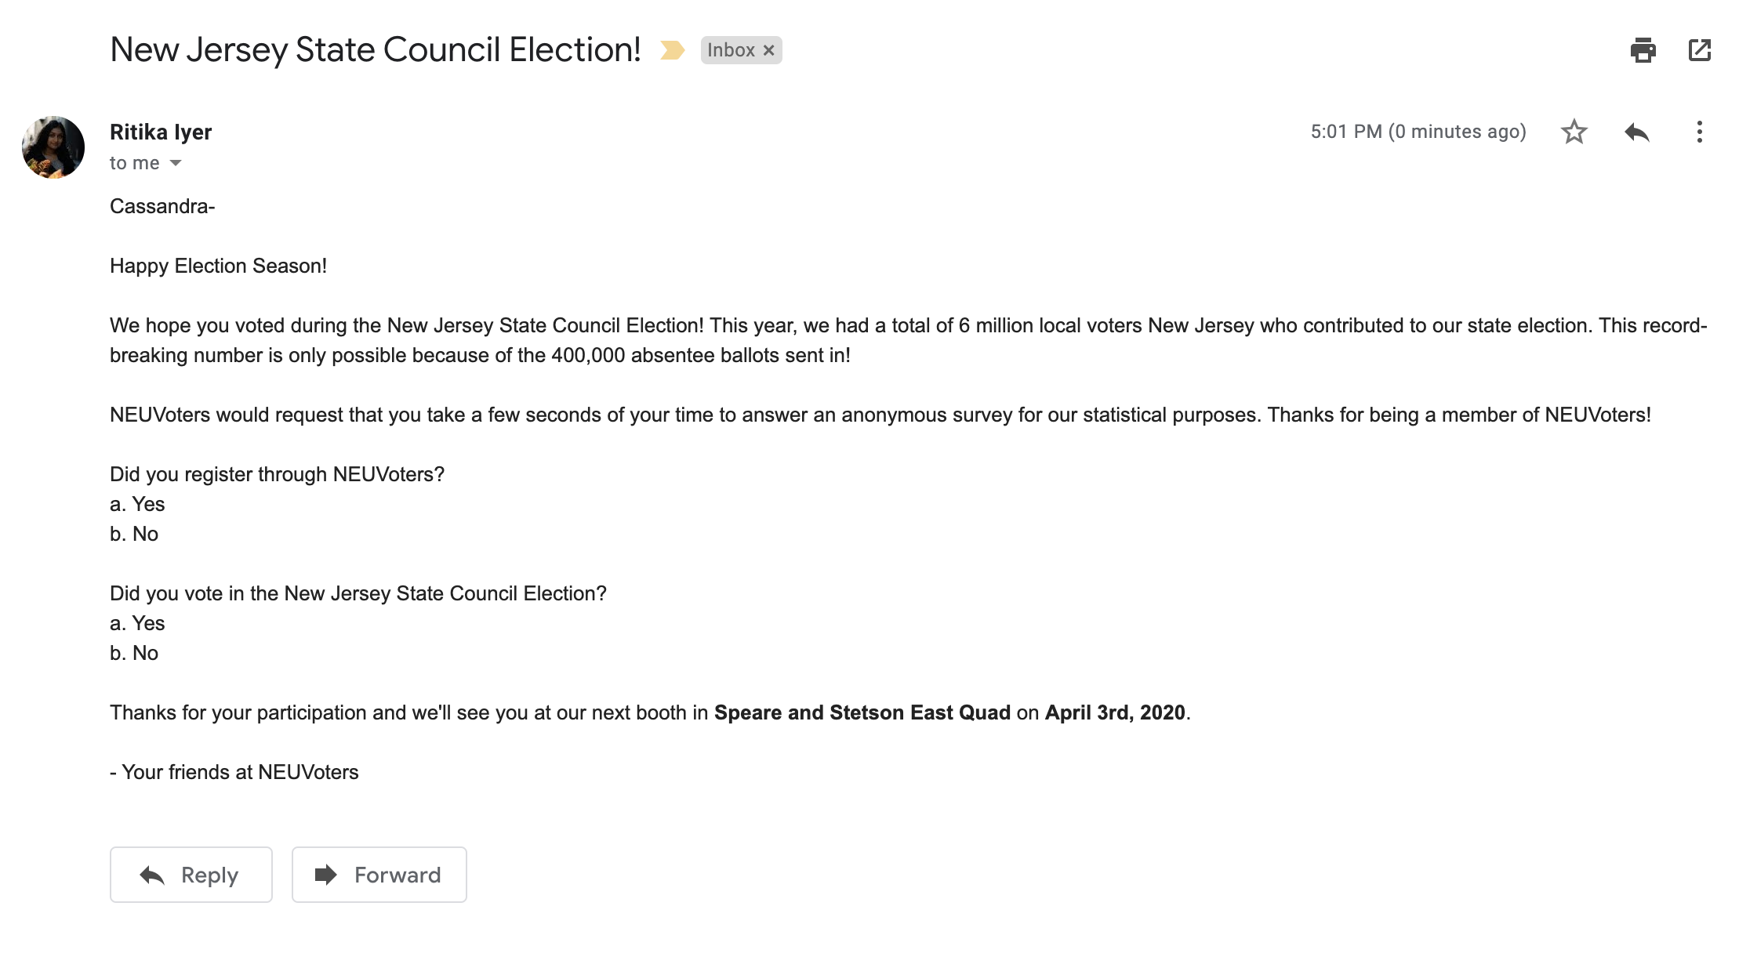

online intervention
NEUVoters
Notes:
nebai

Slide 24
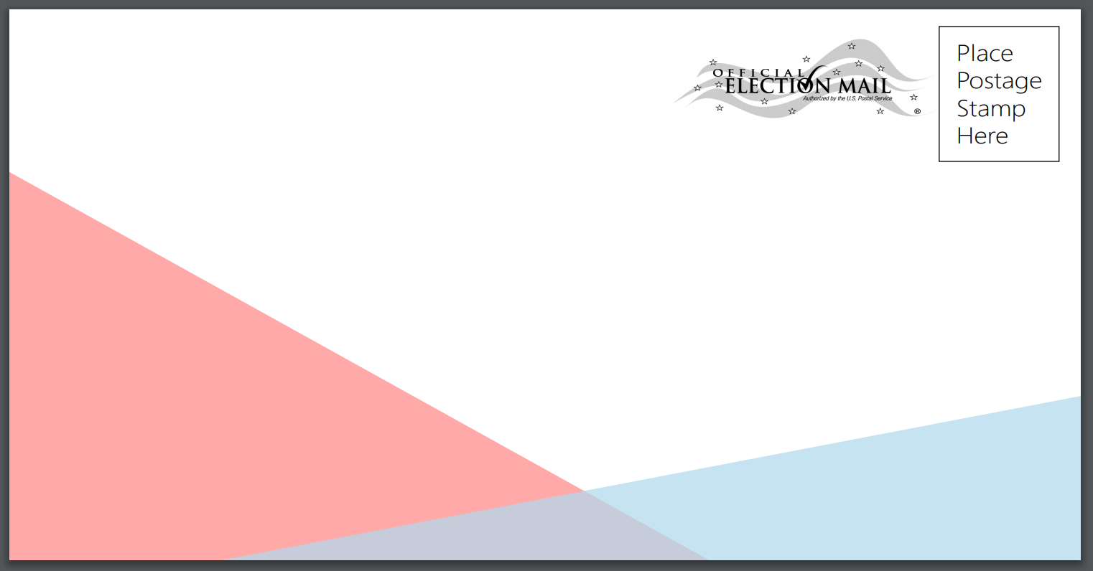

design intervention
Your Local Mail-in-Address Here
Notes:
nebai

Slide 25
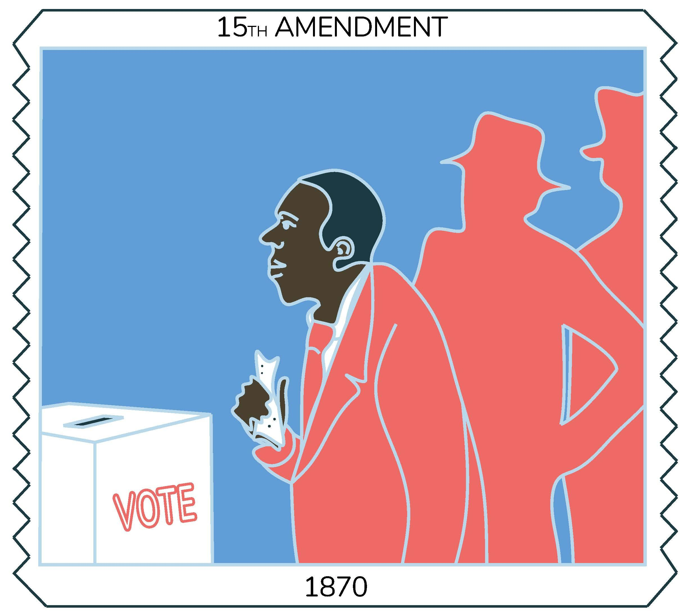
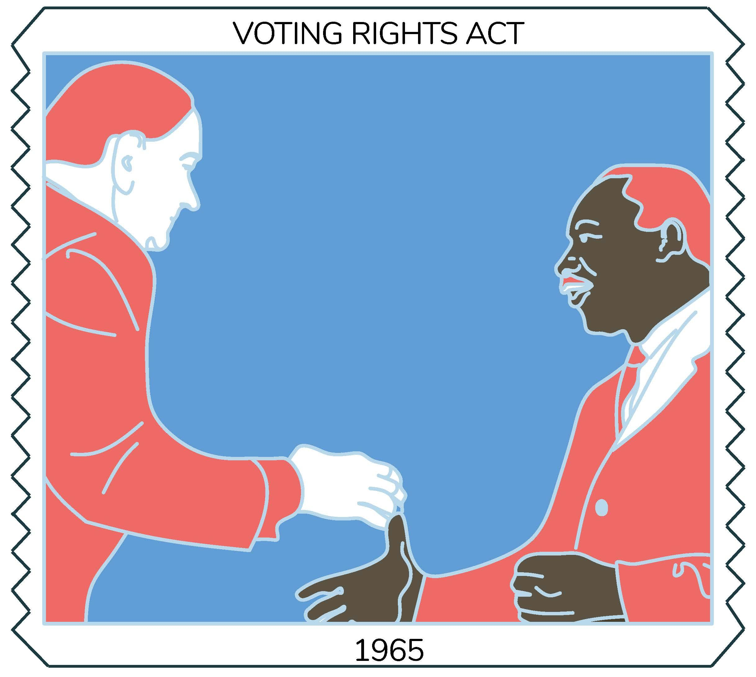


Notes:
nebai

Slide 26
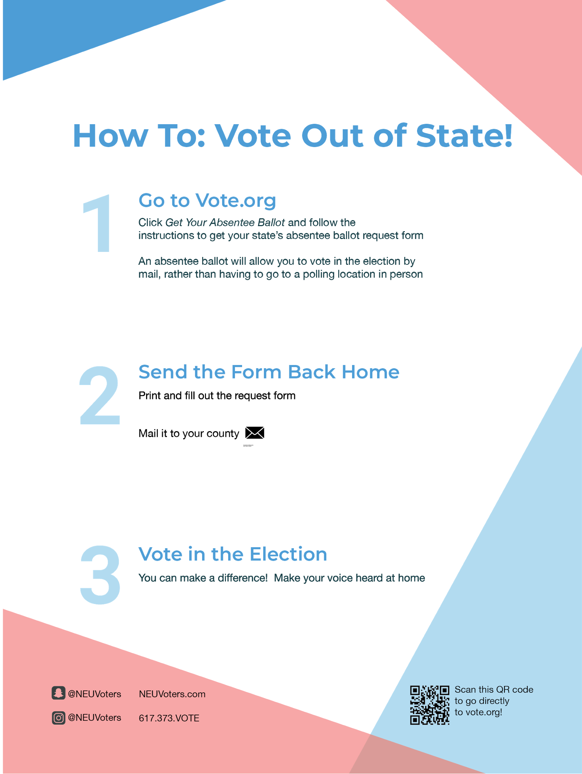
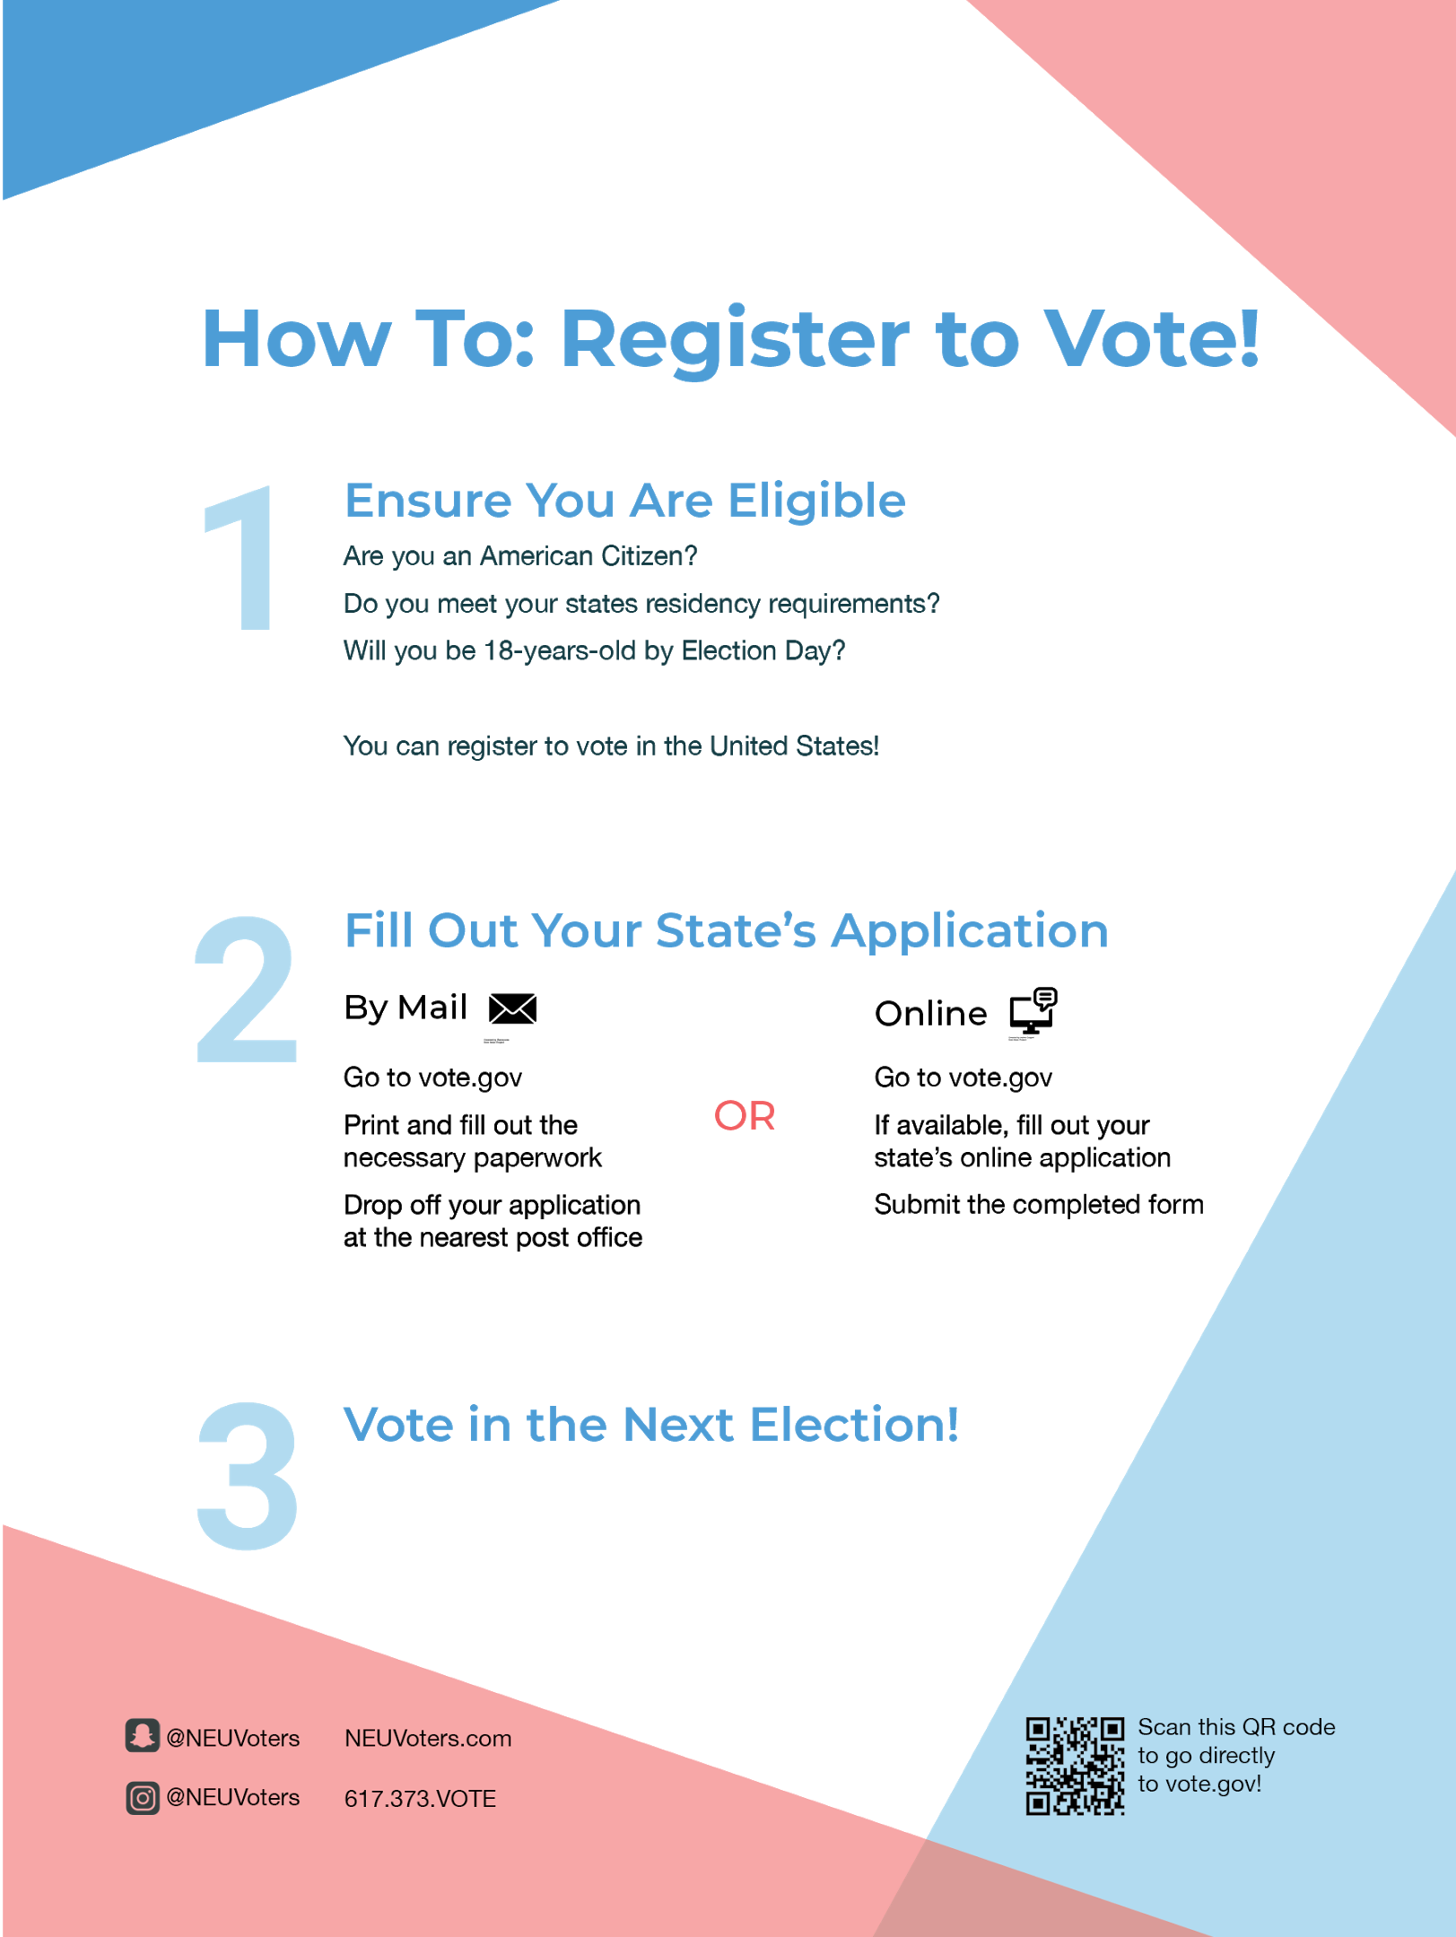
Notes:
nebai

Slide 27

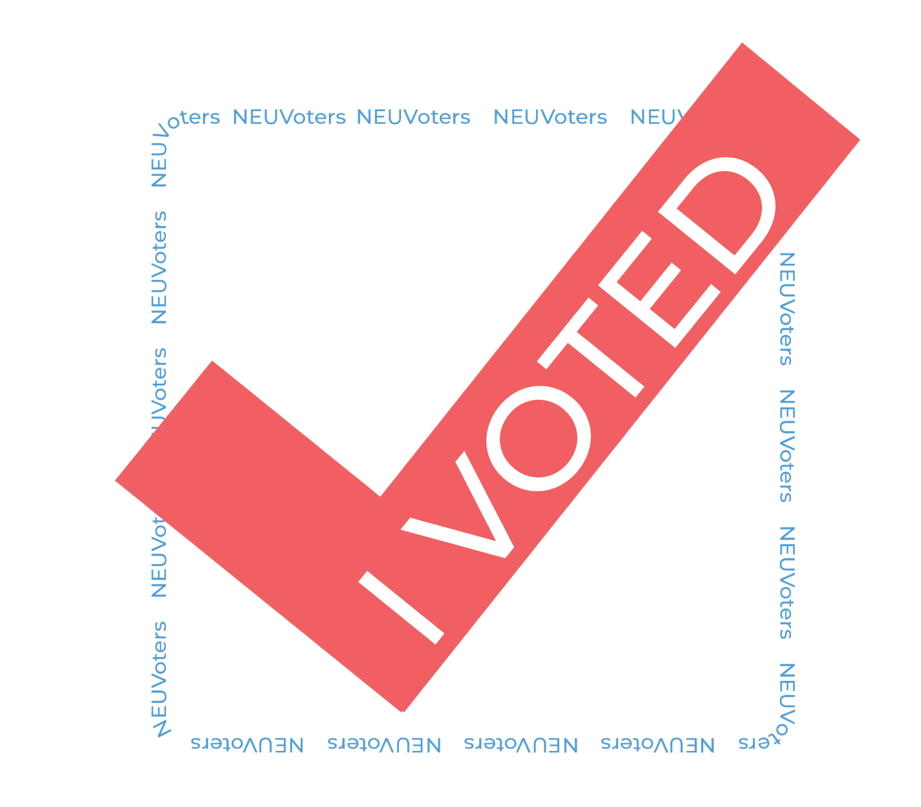

Notes:
nebai

Slide 28
thank you!

